Slide 1
Artificial Intelligence – Datascience – Machine Learning
Whatuup

Slide 2
We’re not talking about robots

Slide 3
Today’s goal: provide valuable insights in AI terminology that will allow you to orientate in the world of AI

Slide 4
Artificial Intelligence
The ability of a machine to show human-like, intelligent behavior.
This involves self learning, contextual interpretation, speech, decision making.

Slide 5
Machine Learning
The ability of a machine to continuously improve itself or its behavior based on past experiences
A class of algorithms or techniques for automatically capturing complex data patterns in the form of a model
Deep Learning: A class of machine learning algorithms that uses neural networks with more than one hidden layer

Slide 6
DataScience
Everything around working with data:
data collection
data clean up
data modelling
extraction of relevant insights from data
making prediction
storytelling
bussiness knowledge

Slide 7
Why the hype?
Everybody wants the value that AI can deliver
AI makes for fancy headlines
Many companies are sitting on a lot of data

Slide 8
WIIFT
Predicting consumer needs
Identifying relationships that no human can interpret
Shaving out repetitive tasks

Slide 9
Common Pitfalls

Slide 13
Features and target values
Based on the features we predict the target value

Slide 14
True Positive – False Positive – True Negative – False Negative

Slide 15
Accuracy, precision, recall
Accuracy: Of all the predictions I made, how right was I?
Precision: Of all the once that I predicted to be true, how many are actually true
Recall: Of all the once that I should have said to be true, how many did I say were true

Slide 16
Time for a Game of Predictions
Who has the corona virus?

Slide 17
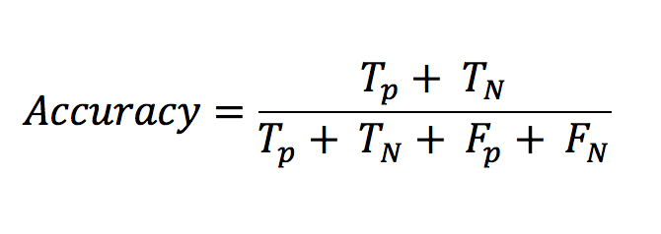
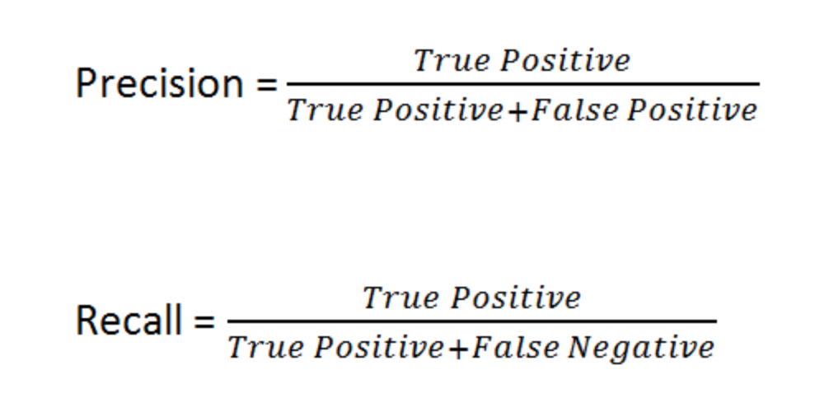
Accuracy, precision, recall

Slide 18
Classification vs Regression Vs Clustering
Regression: predicting a value!
Classification: classifying in categories that are known upfront
Clustering: grouping into groups that are not known upfront

Slide 19
Supervised vs unsupervised learning
Supervised: you know what you want to predict upfront. The target is known. The data is labeled
Unsupervised Learning: you don’t know what you will predict upfront. The data is unlabeld.

Slide 20
Supervised vs unsupervised learning

Slide 21
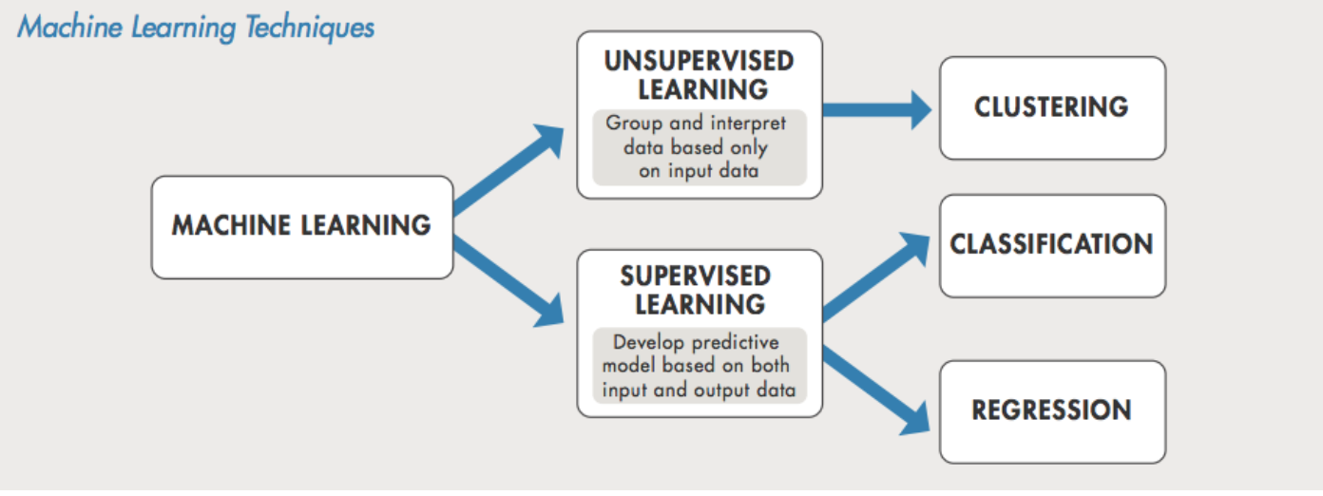

Slide 22
Correlation and bias
Correlation: explains how one or more variables are related to each other.
Bias: “vooringenomenheid”. Every form of bias in your data.
Selection bias
Activity bias
...

Slide 23
Normalization and standardization
Putting all values to the same scale
The terms normalization and standardization are sometimes used interchangeably, but they usually refer to different things. Normalization usually means to scale a variable to have a values between 0 and 1, while standardization transforms data to have a mean of zero and a standard deviation of 1.

Slide 24
Models
The model used to go from your input features to your outcome target value
DecisionTree
RandomForest
K-means
LinearRegression

Slide 26
Deep learning: Neural Networks

Slide 27
Deep learning: Neural Networks
Neuron: accumulates and passes the information forward. “fires”
Inputs: the information going towards the neuron
Weights: the relative weight of an input
Activation Function: determines whether or not a neuron fires

Slide 28
Deep learning: Neural Networks

Slide 29
Tooling

Slide 30
Tooling: autopilot

Slide 31
Hands-on!

Slide 32
Thank you!!

Slide 33
Op voorhand
Jupyter notebook open
Sagemaker open
sagemaker autopilot open

Slide 34
https://www.kaggle.com/arpita28/analysis-of-spotify-trends
http://localhost:8888/notebooks/Google%20Drive/EHB/Machine%20Learning/Opdracht_ML_Nick_Van_Hoof/classification/DiabeticClassificationExam.ipynb

